Slide 1

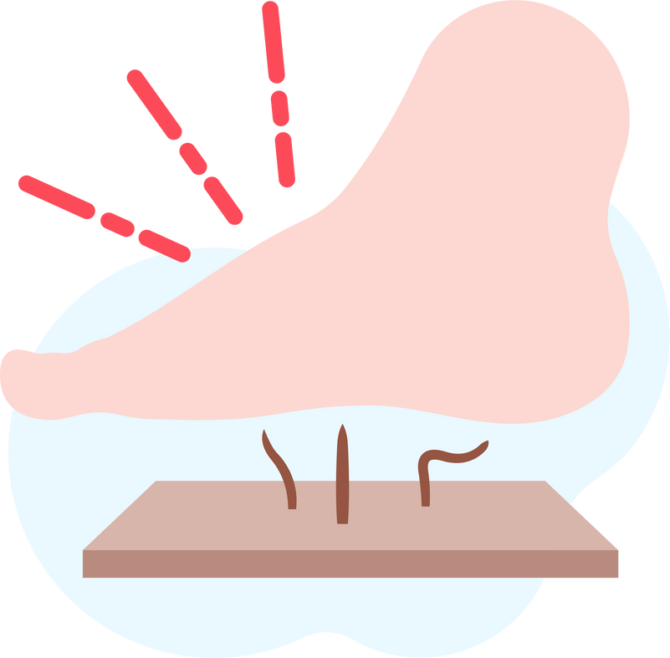

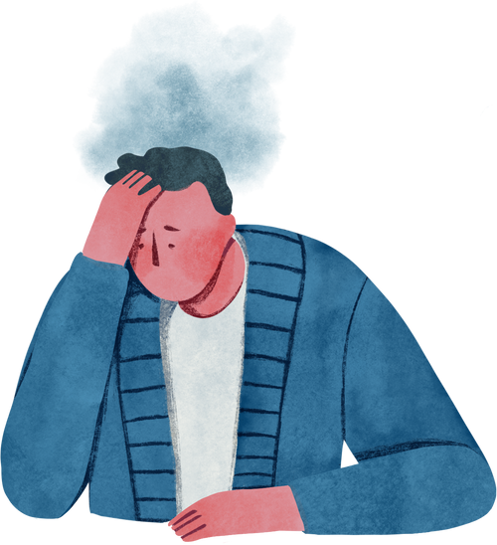

Lightning Talk 3:
Users Needs & Requirements
PRESSURE SENSOR PATCH
sdmay25-12
Advisor: Santosh Pandey
Client: BAE Systems

Slide 2
Project Overview
Problem
Importance
Context
Pressure sores can lead to severe complications, including infection and hospitalization. Preventing these sores can significantly improve the quality of life for affected individuals.
This project involves developing a wearable patch with sensors that detect excessive pressure. The system will alert users to adjust their position, reducing the risk of sores.
The project aims to prevent pressure sores in individuals with traumatic injuries by monitoring skin pressure in real-time

Slide 3
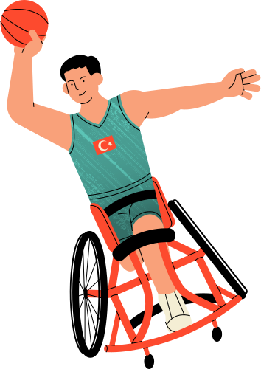

Users Needs
Comfort & Ease of Use
The patch must be non-intrusive and comfortable for long-term wear.

Slide 4

Users Needs
Real-time Alerts
Users need immediate notifications when pressure levels exceed safe thresholds on their damaged area of skin. This allows them to shift their position and avoid damaging their health conditions.

Slide 5

Users Needs
Data Insights
Individuals with traumatic injury and their caregivers need clear, actionable data on pressure exposure on affected area to take preventative action.

Slide 6

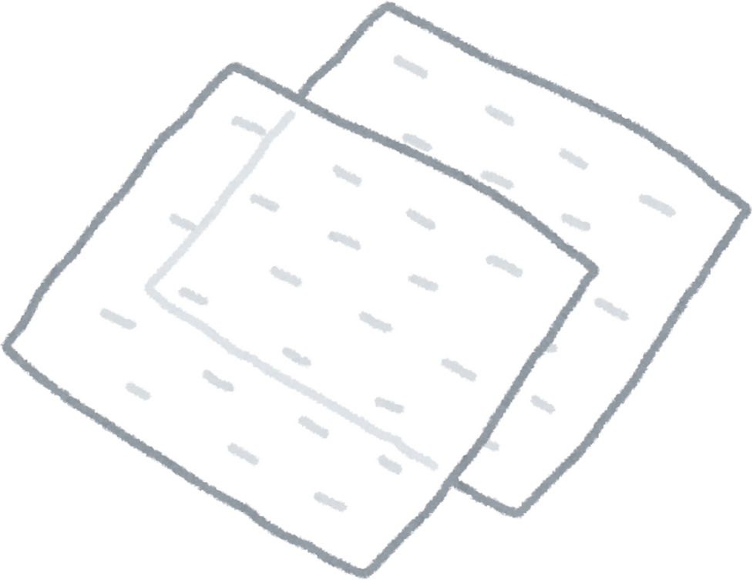
Users Needs
Durability
The patch must withstand daily activities without malfunctioning.

Slide 7
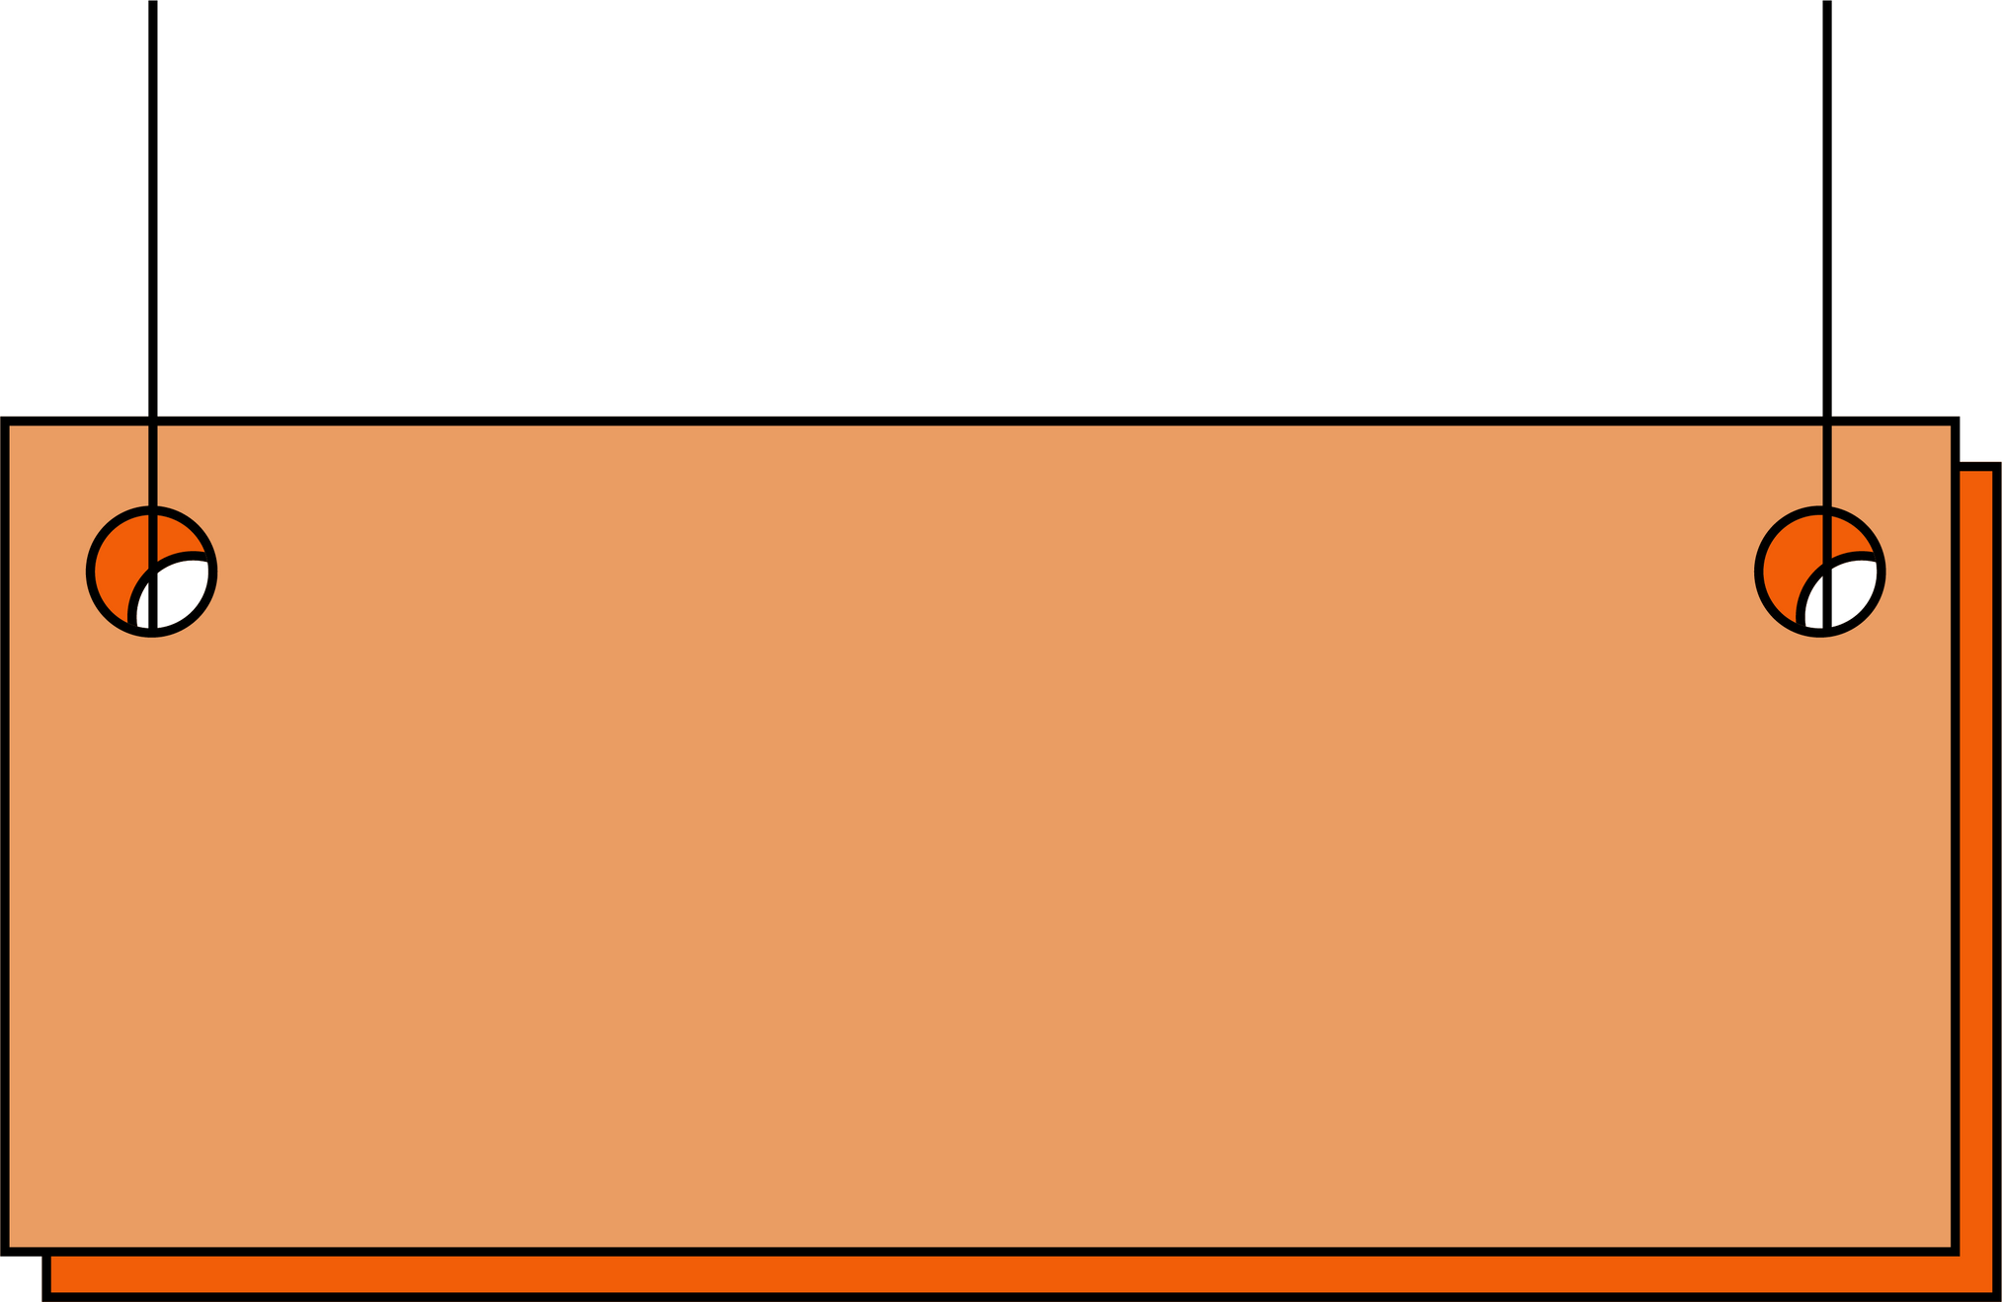
Requirements
Functional Requirements
Pressure Detection:
The sensor must accurately detect and
report pressure above thresholds.
User Alerts:
The app must provide timely notifications
through sound or vibration.
Small and Frictionless:
Sensor must be small and not cause additoanl protrusions

Slide 8
Requirements
Non-Functional Requirements
Battery Life:
The patch should last at least 12 hours on a single charge.
Water Resistance:
The device should withstand sweat and light water exposure.

Slide 9
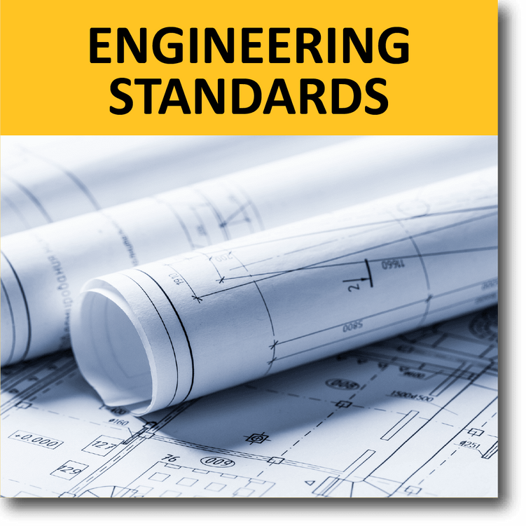
Engineering Standards
  Pressure Sensor Patch Projects
ISO/IEC/IEEE International Standard - Software and systems engineering - Software testing -- Part 2: Test processes
  https://standards.ieee.org/ieee/29119-2/7498/
2. ISO/IEC/IEEE International Standard - Systems and Software Engineering -- Life Cycle Management -- Part 6: Systems and Software Integration
  https://standards.ieee.org/ieee/24748-6/10373/

Slide 10
Engineering Standards
3. ISO/IEC/IEEE International Standard - Systems and Software Engineering--Life Cycle Management--Part 5: Software Development Planning
  https://standards.ieee.org/ieee/24748-5/5664/
4. IEEE 802 Nendica Report: Flexible Factory IoT: Use Cases and Communication Requirements for Wired and Wireless Bridged Networks
  https://standards.ieee.org/ieee/White_Paper/10123/

Slide 11
Conclusion
The pressure sensor patch provides a practical solution to prevent pressure sores, a serious risk for individuals with limited mobility. By offering real-time alerts and data insights, it enables users to take on new challenges without the constant fear of developing pressure sores.
This technology empowers patients, caregivers, and healthcare providers to focus on recovery and quality of life with confidence.

